Slide 1
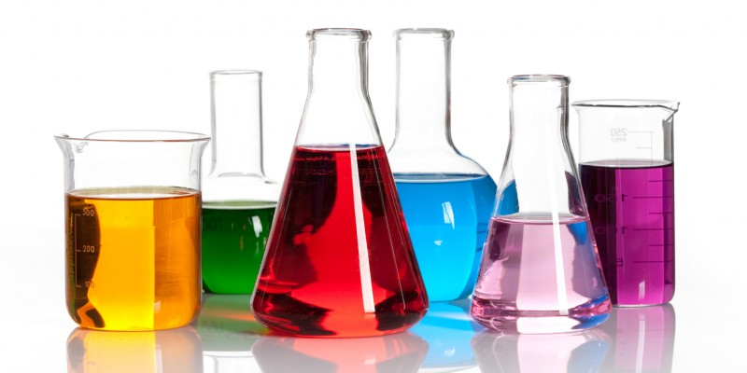
Introduction to Solutions & Concentration
October 2017

Slide 2
Solutions
Solute:
the substance that gets dissolved
can be solid, liquid or gas
Solvent:
the substance that does the dissolving
can be solid, liquid or gas
we will be using water as the solvent

Slide 3
CONCENTRATION:
Describes the amount of solute in a given volume of solution
Can be expressed as: percent, ppm or molar concentration

Slide 4
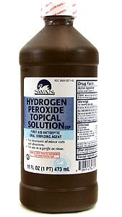
1) Percent: volume per volume (v/v)
3% v/v means:
3 mL of H₂O_{2(l)} / 100 mL hydrogen peroxide solution

Slide 5
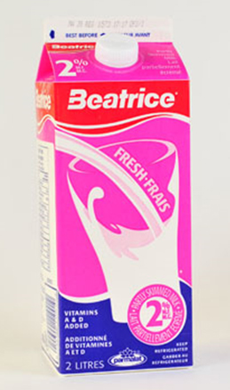
Percent: mass per volume (m/v)
2% m/v means:
2 grams of milk fat/ 100 mL milk solution

Slide 6
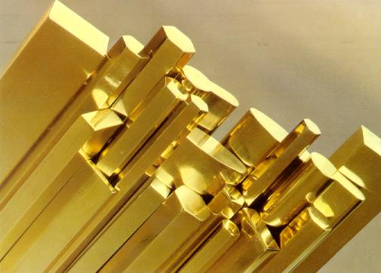
Percent: mass per mass (m/m)
Brass:
67% copper
33% zinc

Slide 7
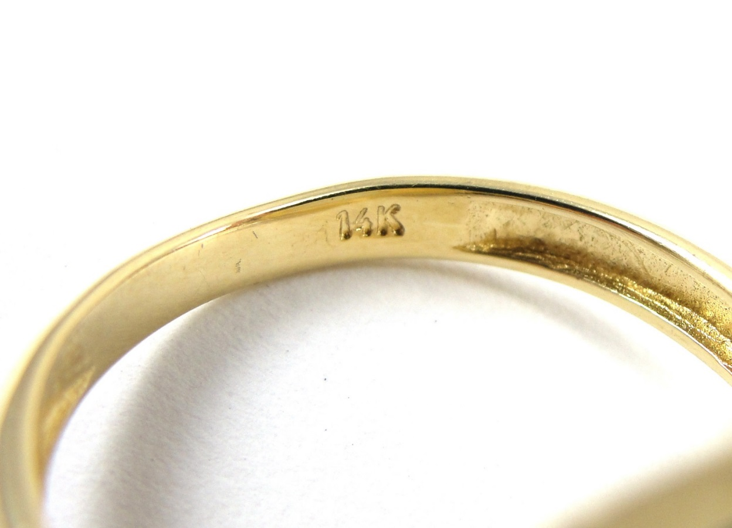
14 karat gold
14 parts pure gold
10 parts other metals (copper, silver zinc)
24 kt

Slide 8
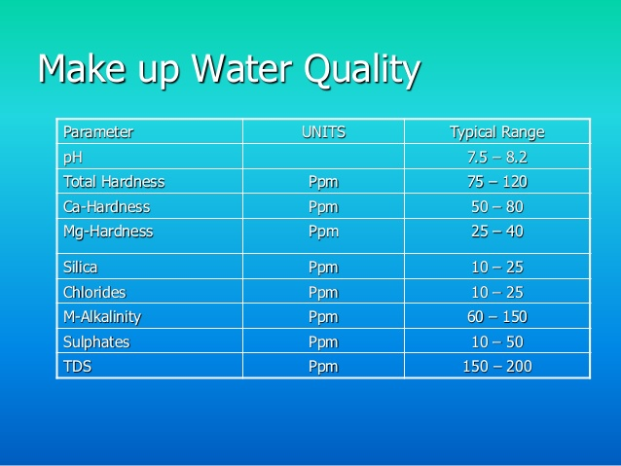
2) Parts per million and parts per billion
Used when concentrations are very low
50 ppm calcium
=> 50 drops of calcium for every 1000000 drops of water

Slide 9
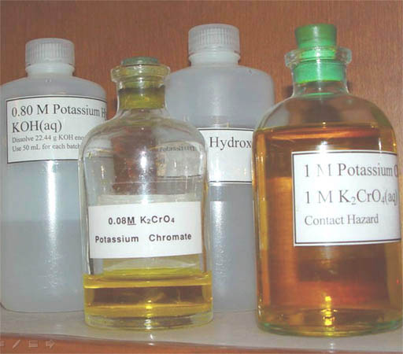
3) MOLAR CONCENTRATION
This is the one used in chemistry.
Is the number of moles of solute in 1 L of solution
Units are mol/L
C = n/V

Slide 10
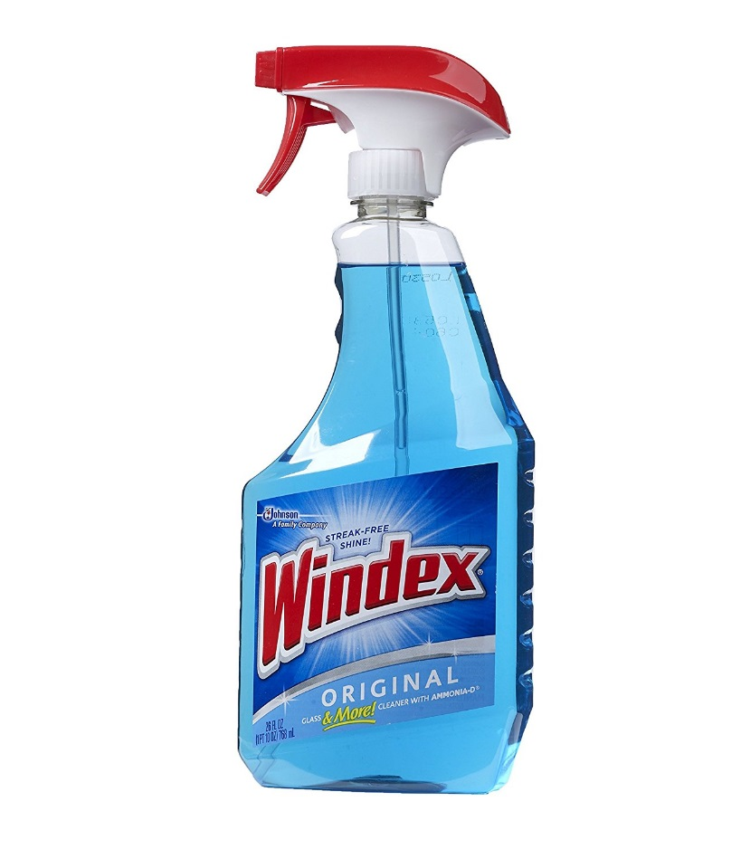
Calculate the molar concentration of the following solutions:
A 1.0 L Windex solution contains 0.143 moles of ammonium hydroxide, NH₄OH.

Slide 11
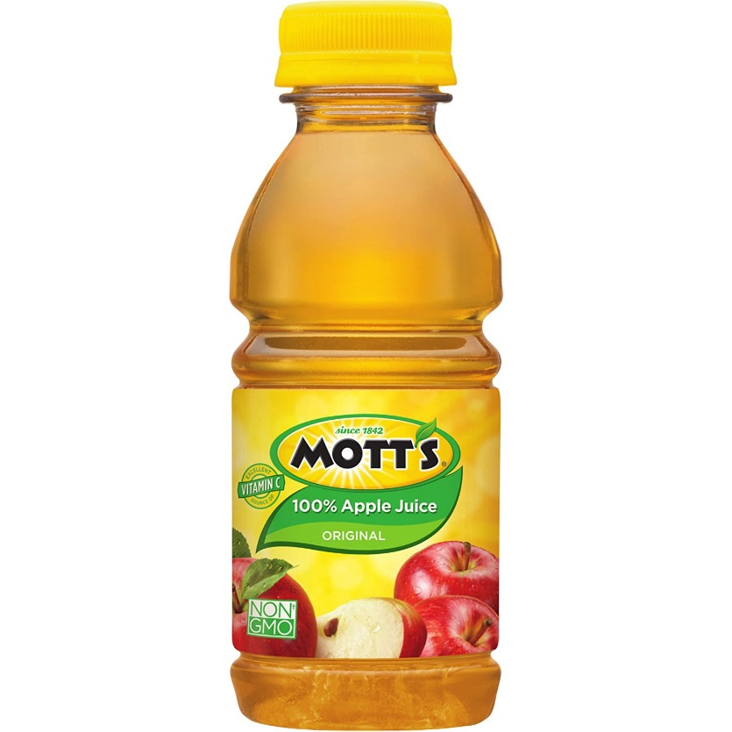
Calculate the molar concentration of the following solutions:
A 250 mL bottle of apple juice contains 0.139 moles of sugar, C₆H₁₂O₆.

Slide 12
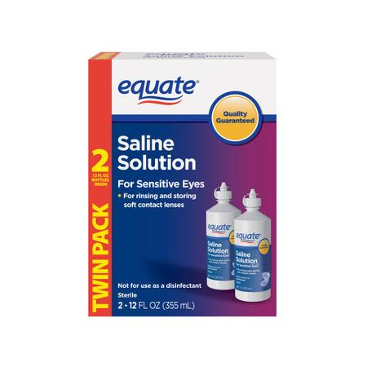
Calculate the molar concentration of the following solutions:
A 1.0 L saline solution contains 0.900 g of
NaCl.

Slide 13
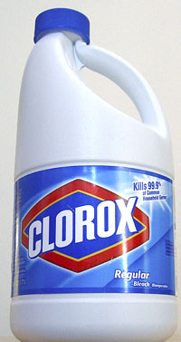
Calculate the molar concentration of the following solutions:
A 3.75 L container of typical household bleach contains 196.88 g of sodium hypochlorite, NaOCl.

Slide 14
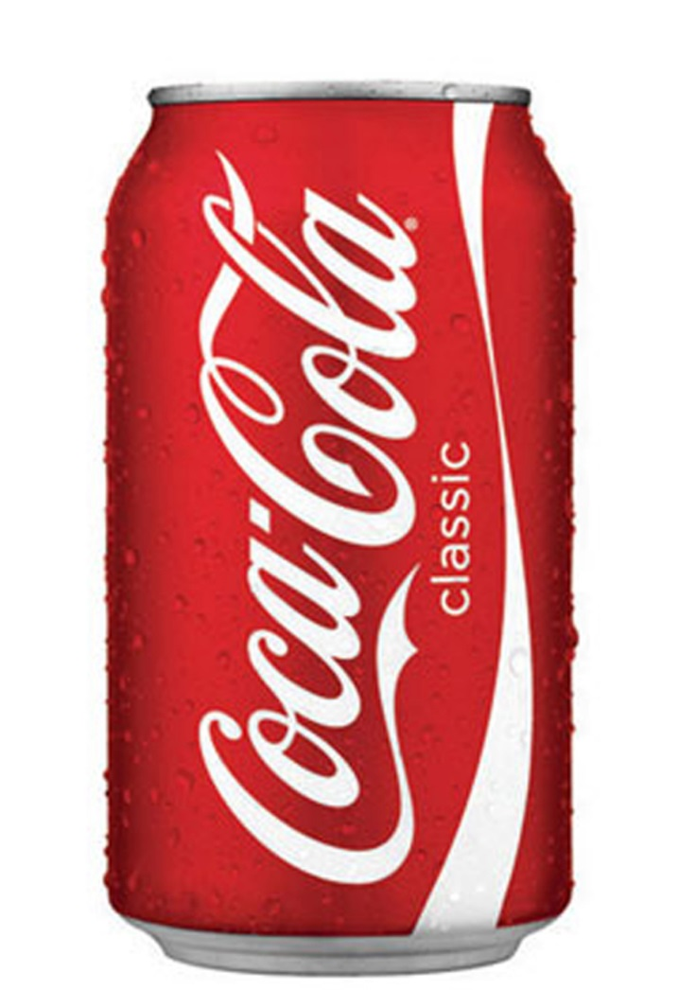
Calculate the molar concentration of the following solutions:
A 360 mL serving of coke contains 39 g of fructose, C₆H₁₂O₆.

Slide 15
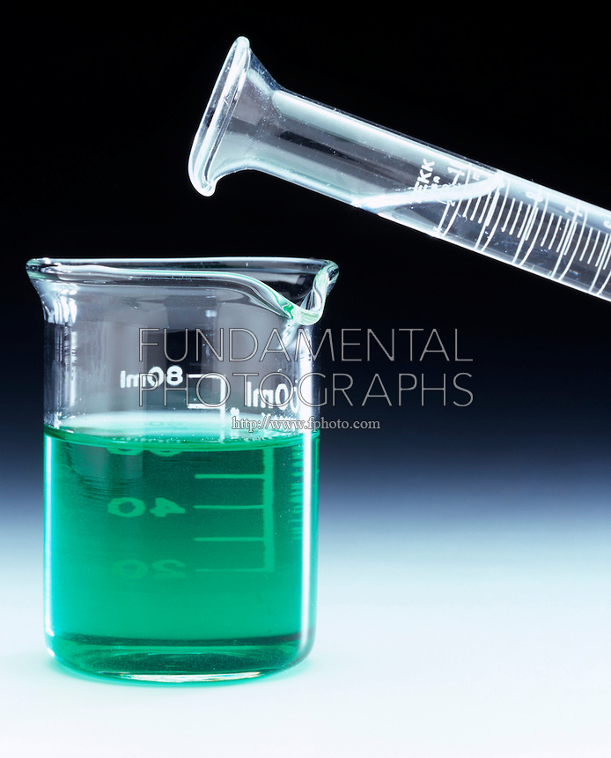
You are asked to make 150.00 mL of 0.500 mol/L nickel (II) chloride solution.
How many grams of nickel (II) chloride would you need to mass out?

